Slide 1

P1 Project Introduction to Hive
Members:
Jason McClintock Jessica Hori
Shawn Sampson

Slide 2
What is Apache Hive?
Software utility built on top of Hadoop for easy data query and data analysis.
Why do we need it?
Built as an answer for querying large datasets that traditional Relational Databases do not handle. Transforms HiveQL queries into MapReduce jobs.

Slide 3



Questions and Dataset
User with the highest average rating for a specific year
Top 25 ranking movies for a specific year
Top 25 rated movies having at least 100 views.

Slide 4
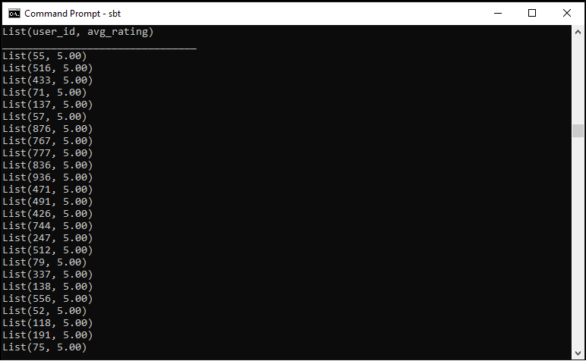


User with the highest average rating for a specific year
Hive command: SELECT user_id, avg_rating FROM ( SELECT user_id, CAST(AVG(rating) AS DECIMAL(10,2)) AS avg_rating FROM ratings INNER JOIN movies ON ratings.movie_id = movies.movie_id WHERE movies.release_date RLIKE '.*(1993).*' GROUP BY user_id) tmp ORDER BY avg_rating DESC LIMIT 25
Result: 5 was the highest average rating for 1993
Why are we looking for this data?
To figure out how users rate their movies, to look at trends on whether they only give high or low ratings too frequently, whether they are balanced raters.
What can it be used for?
To determine the quality of movies for a given year. If you compare the ratings across years, you can compare the quality of movie releases based on viewer input.
55|37|M|programmer|01331
Phillipston, MA
777|63|M|programmer|01810
Andover, MA

Slide 5
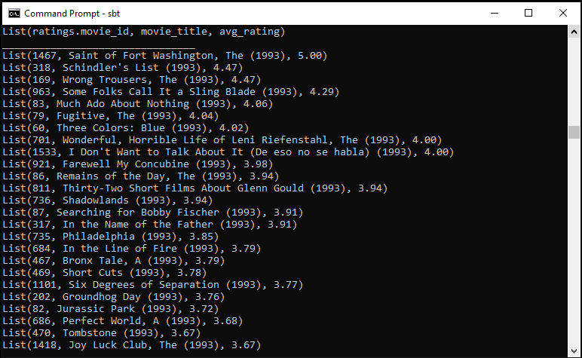
Top 25 ranking movies for a specific year
Hive command: SELECT movie_title, CAST(AVG(rating) AS DECIMAL(10,2)) AS avg_rating FROM ratings INNER JOIN movies ON ratings.movie_id = movies.movie_id WHERE movies.release_date RLIKE '.*(1993).*' GROUP BY ratings.movie_id, movie_title ORDER BY avg_rating DESC LIMIT 25;
Result: Jurassic Park and Groundhog Day are notable titles
Why are we looking for this data?
To narrow down the best movies in a given year. You can compare trends across specific years.
What can it be used for?
To get suggestions of films to watch for the year without having to go through many to find ones you like. Additionally, film makers can know what kind of movies were popular, such as storylines and genre to potentially inspire future work.

Slide 6
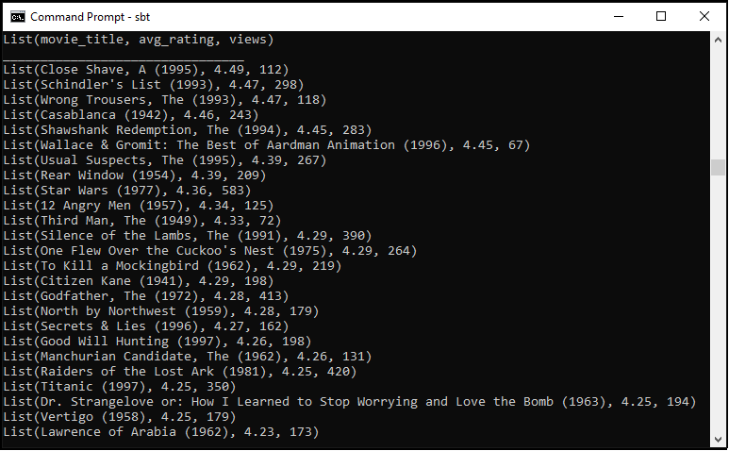
Top 25 rated movies having at least 100 views
Hive command: SELECT movie_title, avg_rating, views FROM (SELECT movie_title, CAST(AVG(rating) AS DECIMAL(10,2)) AS avg_rating, COUNT(rating) AS views FROM ratings INNER JOIN movies ON ratings.movie_id = movies.movie_id GROUP BY ratings.movie_id, movie_title ) tmp WHERE views >= 100 GROUP BY movie_title, avg_rating, views ORDER BY avg_rating DESC, views DESC LIMIT 25;
Result: Star Wars, The Godfather, Titanic and Silence of the Lambs are notable titles
Why are we looking for this data?
To check ratings with a minimum viewer rate to get adequate rating data.
What can it be used for?
This is used to get the top ratings for all movies in the database. Using this data, you can determine not only the most popular movies for viewers, but you can use this for movie screenings as you are bound to find something that attendees can agree with.

Slide 7
Questions?

